Slide 1
KEY MANAGEMENT
Cryptography & Network Security

Slide 2
What is KEY MANAGEMENT?
Generate the Key
👉
Use it
👉
Destroy

Slide 3
Why need to study?
How we can distribute Public Keys
How to use public-key encryption to distribute secret keys

Slide 4
How we can distribute Public Keys
Public Announcement
Publicly available Directory
Public-key Authority
Public-key Certificates

Slide 5

Public Announcement

Slide 6
Public Announcement
Pros
Easy
Quick
Cons
Misunderstanding
Forgettable

Slide 7

Publicly available Directory

Slide 8
Publicly available Directory
Pros
Easy
Instant Service
Cons
Authentication

Slide 9
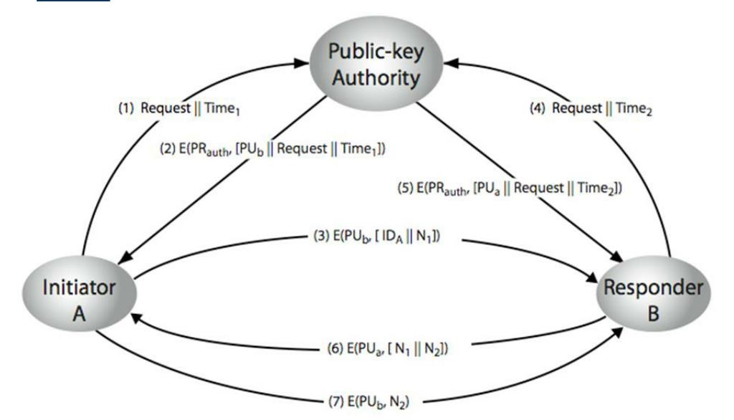
Public-key Authority

Slide 10
Public-key Authority
Pros
Authorized info
Cons
Bottleneck Situation

Slide 11
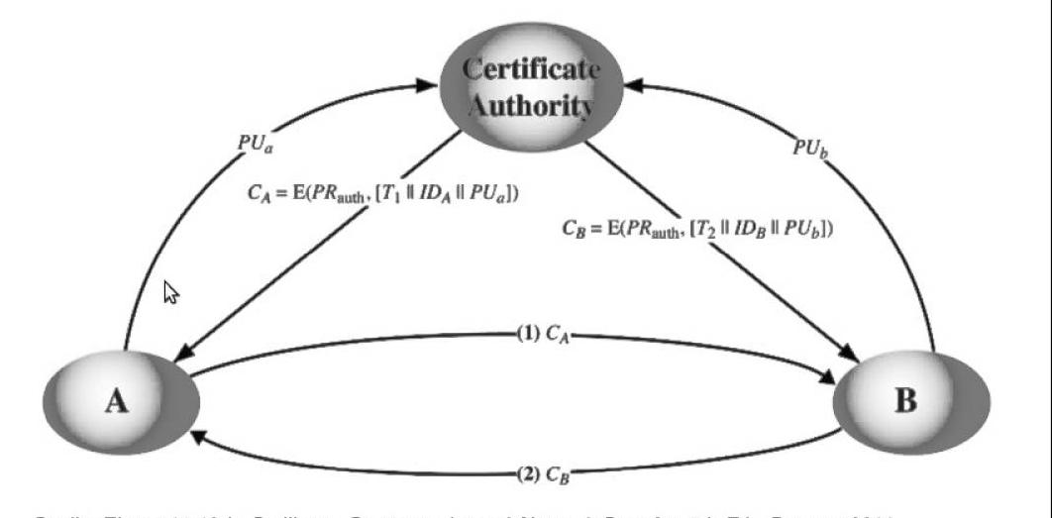
Public-Key Certificate

Slide 12
Public-Key Certificate
Pros
No Bottleneck problem
Authorized

Slide 13
Thank You

